Slide 1
Indicators of progress and monitoring
Integrated National Implementation of SDGs and International Chemicals and Waste Agreements
International Expert and Stakeholder Workshop
Geneva, Switzerland, 11-13 April 2016
Tatiana Terekhova (Secretariat of the Basel, Rotterdam and Stockholm Conventions
Carolyn Vickers (WHO)
Brenda Koekkoek (UNEP Chemicals and Waste Branch, SAICM Secretariat)

Slide 2
Outline
PART I: Sound management of chemicals and waste indicators under the SDGs
PART II: Measuring progress at the global and regional levels
PART III: Measuring progress at the national level
I
II
III

Slide 3
PART I: Indicators on chemicals and waste under the SDGs

Slide 4
Brief overview of the process
In 2014, the UN General Assembly tasked the United Nations Statistical Commission (UNSC) with the development of the SDG indicator framework (by March 2016).
In 2015, the UNSC established the Inter-agency and Expert Group on Sustainable Development Goal Indicators (IAEG-SDGs) to develop the SDG indicators for adoption to the UNSC.
The IAEG-SDG includes country members with UN agencies and others as observers.
In Feb 2016, the IAEG submitted the indicators for endorsement. In March 216, the UNSC adopted the proposed list of indicators.

Slide 5
Tiered approach
Tier I: indicators where there is an adopted methodology and data available for many countries;
Tier II: indicators where there is a methodology but it has not been adopted, and less data for countries;
Tier III: indicators where there is not an agreed methodology.

Slide 6
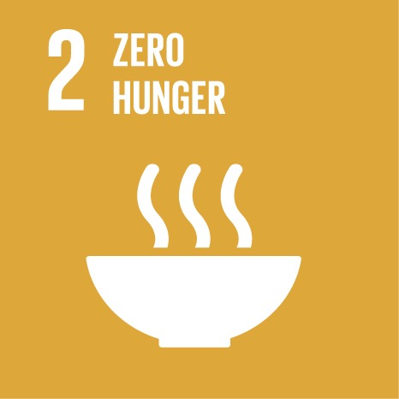


Targets | Indicators | Custodian Agency(ies)
2.4 By 2030, ensure sustainable food production systems and implement resilient agricultural practices that increase productivity and production, that help maintain ecosystems, that strengthen capacity for adaptation to climate change, extreme weather, drought, flooding and other disasters and that progressively improve land and soil quality | 2.4.1 Proportion of agricultural area under productive and sustainable agriculture | FAO
3.9 By 2030, substantially reduce the number of deaths and illnesses from hazardous chemicals and air, water and soil pollution and contamination 3.d Strengthen the capacity of all countries, in particular developing countries, for early warning, risk reduction and management of national and global health risks | 3.9.1 Mortality rate attributed to household and ambient air pollution 3.9.2 Mortality rate attributed to unsafe water, unsafe sanitation and lack of hygiene (exposure to unsafe Water, Sanitation and Hygiene for All (WASH) services) 3.9.3 Mortality rate due to unintentional poisoning 3.d.1 International Health Regulations (IHR) capacity and health emergency preparedness | WHO
6.3 By 2030, improve water quality by reducing pollution, eliminating dumping and minimizing release of hazardous chemicals and materials, halving the proportion of untreated wastewater and substantially increasing recycling and safe reuse globally | 6.3.1 Proportion of wastewater safely treated 6.3.2 Proportion of bodies of water with good ambient water quality agriculture | UN-Habitat, WHO, UNSD FAO

Slide 7

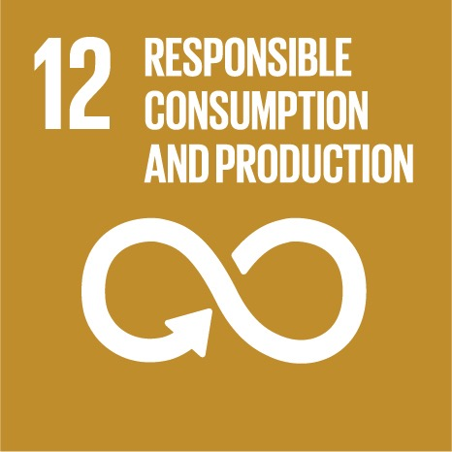
Targets | Indicators | Custodian Agency(ies)
11.6 By 2030, reduce the adverse per capita environmental impact of cities, including by paying special attention to air quality and municipal and other waste management | 11.6.1 Proportion of urban solid waste regularly collected and with adequate final discharge out of total urban solid waste generated, by cities 11.6.2 Annual mean levels of fine particulate matter (e.g. PM2.5 and PM10) in cities (population weighted) | UN-Habitat, UNSD WHO
12.4 By 2020, achieve the environmentally sound management of chemicals and all wastes throughout their life cycle, in accordance with agreed international frameworks, and significantly reduce their release to air, water and soil in order to minimize their adverse impacts on human health and the environment | 12.4.1 Number of parties to international multilateral environmental agreements on hazardous waste, and other chemicals that meet their commitments and obligations in transmitting information as required by each relevant agreement 12.4.2 Hazardous waste generated per capita and proportion of hazardous waste treated, by type of treatment | UNEP UNSD, UNEP
12.5 By 2030, substantially reduce waste generation through prevention, reduction, recycling and reuse | 12.5.1 National recycling rate, tons of material recycled .5.1 National recycling rate, tons of material recycled | UNSD, UNEP

Slide 8


Targets | Indicators | Custodian Agency(ies)
14.1 By 2025, prevent and significantly reduce marine pollution of all kinds, in particular from land-based activities, including marine debris and nutrient pollution | 14.1.1 Index of coastal eutrophication and floating plastic debris density | UNEP
17.7 Promote the development, transfer, dissemination and diffusion of environmentally sound technologies to developing countries on favourable terms, including on concessional and preferential terms, as mutually agreed | 17.7.1 Total amount of approved funding for developing countries to promote the development, transfer, dissemination and diffusion of environmentally sound technologies | OECD, UNEP
17.14 Enhance policy coherence for sustainable development | 17.14.1 Number of countries with mechanisms in place to enhance policy coherence of sustainable development | OECD, UNEP

Slide 9
Indicators | Data
12.4.1 Number of parties to international multilateral environmental agreements on hazardous waste, and other chemicals that meet their commitments and obligations in transmitting information as required by each relevant agreement 12.4.2 Hazardous waste generated per capita and proportion of hazardous waste treated, by type of treatment | Nomination of national focal and contact points National reports under the Basel and Stockholm Conventions - National Implementation Plans under the Stockholm Convention - Import responses under the Rotterdam Convention -Generation of hazardous wastes under the Basel Convention reports
12.5.1 National recycling rate, tons of material recycled 5.1 National recycling rate, tons of material recycled | - Only data on imports and export of hazardous waste for recycling

Slide 10
PART II: Measuring progress at the global and regional levels

Slide 11
Measuring progress under BRS and Minamata
Basel Convention (183 Parties): annual national reports, Strategic Framework (including 11 indicators)
                Percentage of parties that require the separation of hazardous wastes from non hazardous other wastes;
                Percentage of parties that have national inventories on the generation and disposal of hazardous wastes and other wastes
                Percentage of selected Convention waste streams reused, recycled or recovered.
Rotterdam Convention (155 Parties): Import responses and final regulatory actions
Stockholm Convention (180 Parties): National reports every 4 years, National Implementation Plans, Effectiveness Evaluation and Global Monitoring Plan (including outcome and process indicators)
  Annual releases of specific POPs to air, water, land, releases from products and residues. The data is disaggregated by source category (e. g. ferrous and non-ferrous metal production, transportation, open burning processes, etc.), amounts of specific POPs produced, exported (with specification of purpose, e. g. for permitted use, final disposal), as well as the quantity of production, export/import, destruction of PCBs.
Minamata Convention

Slide 12
Statistics
Number of Parties submitted reports under the Stockholm Convention
                First reporting 45 / Second reporting 95 / Third reporting 71
      Number of Parties submitted NIPs under the Stockholm Convention: 162 (out of 180 Parties)
      Reporting rate under Basel Convention: approx 50 %

Slide 13
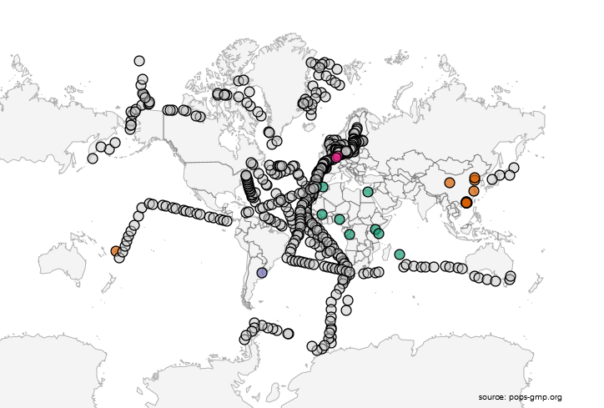
Sampling of PFOS in water:
data availability within the GMP

Slide 14
Trends in concentrations of indicator PCB in human milk (Sum 6 PCB; ng/g fat)
Trends in concentrations of indicator PCB in human milk
(Sum 6 PCB; ng/g fat)
and Minamata
under BRS and Minamata

Slide 15
10 Indicators of progress
1. Countries with National Profiles
2. Countries implementing the GHS
3. Countries with PRTR
4. Countries with Poisons centres
5. Countries with Controls for lead in decorative paint
6. Country achievement of chemical core capacities for the International Health Regulations (2005)

Slide 16
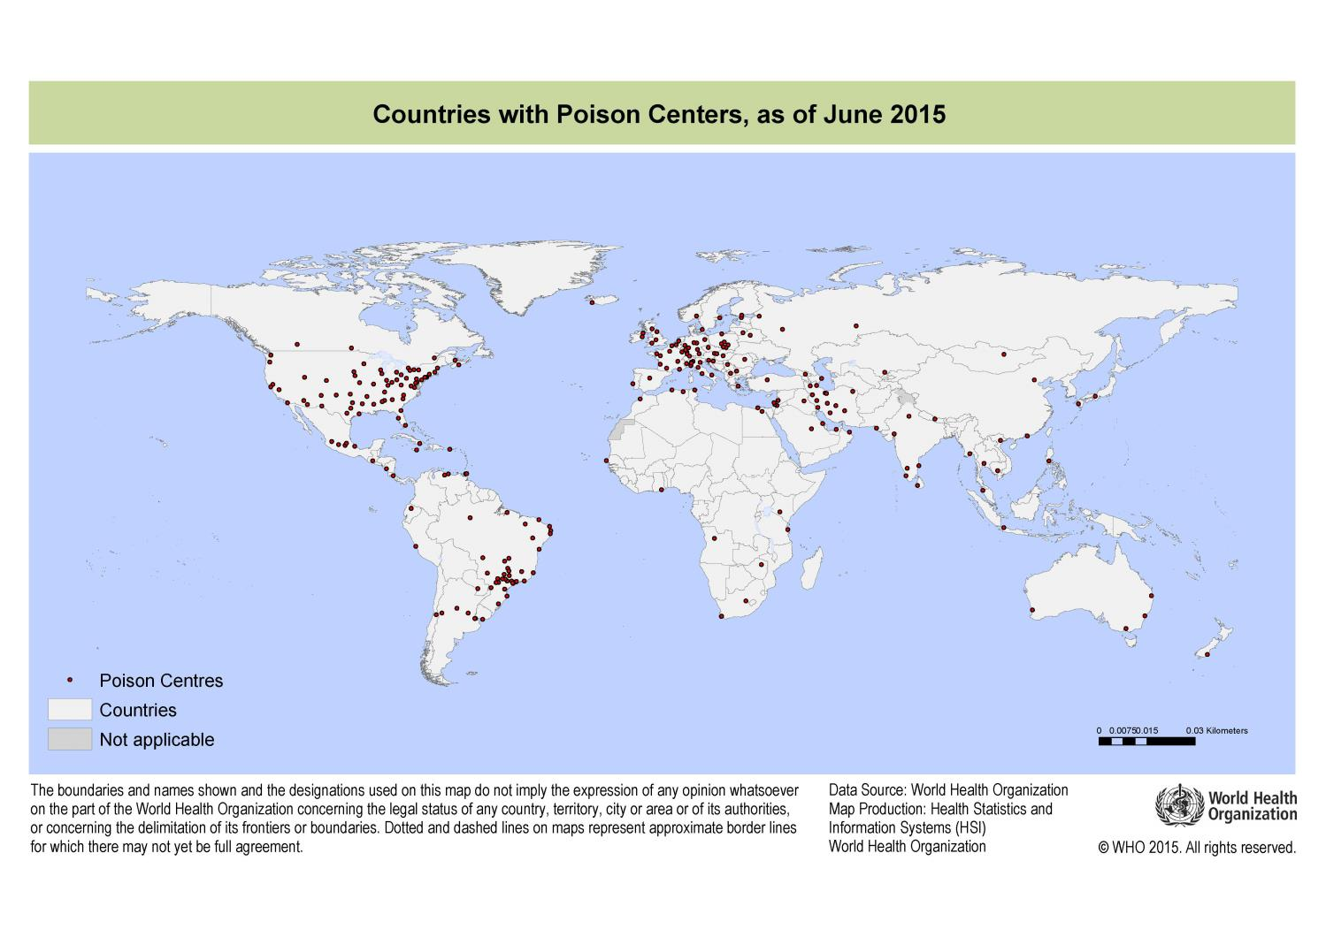

Slide 17
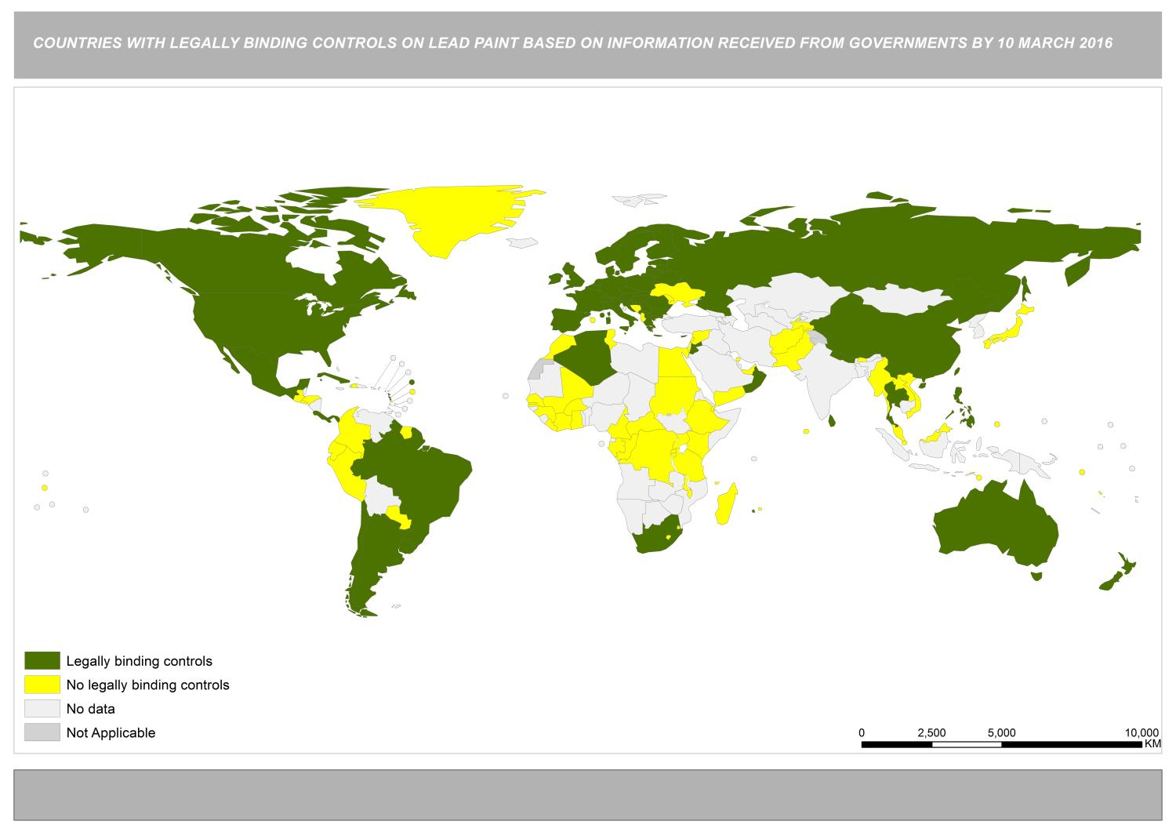

Slide 18
7. Countries with pesticide legislation referencing or based on the FAO/WHO Code of Conduct on Pesticide Management
8. Countries with effective pesticide evaluation and registration system and/or participating in a regional scheme
9. Countries taking action to reduce risks from pesticides
10. Parties to the BRS and Minamata Conventions

Slide 19
Periodic reviews under SAICM
The ICCM is responsible to undertake periodic reviews of SAICM.
ICCM2 adopted 20 indicators to review progress towards the 2020 goal.
Two progress reports and a baseline developed to-date, based on responses to an on-line tool:
    Second report: 2011–2013 (SAICM/ICCM.4/3)
    First report: 2009-2010 (SAICM/ICCM.3/INF/6)
    Baseline report: 2006-2008 (SAICM/ICCM.3/INF/5)
2011-2013 Report: 101 responses to the on-line tool.
    83 Governments, 5 IGOs, 1 private sector NGO and 12 civil society NGOs.
Notes:
The ICCM is responsible to undertake periodic reviews of SAICM, including:
To receive reports from all relevant stakeholders on progress in SAICM implementation and to disseminate information as appropriate;
To evaluate the implementation of SAICM with a view to reviewing progress against the 2020 target;
To report on progress in SAICM implementation to stakeholders.
WHO and SAICM Secretariat have collaborated in developing the reports

Slide 20
Sample of the current indicators

Slide 21
Challenges with SAICM periodic reviews
The activity-based indicators can be subjective:
  based on self-assessment;
  open to variability of responses.
Limited reporting rates.
Does not identify core achievements or support in setting priorities.

Slide 22
SAICM 11 Basic Elements
Legal frameworks that address the life cycle of chemicals and waste
Relevant enforcement and compliance mechanisms
Implementation of chemicals and waste-related multilateral environmental agreements, as well as health, labour and other relevant conventions and voluntary mechanisms
Strong institutional frameworks & coordination mechanisms among relevant stakeholders
Collection & systems for the transparent sharing of relevant data and information among all relevant stakeholders using a life cycle approach, such as the implementation of GHS
Industry participation and defined responsibility across the life cycle, including cost recovery policies and systems as well as the incorporation of sound chemicals management into corporate policies and practices
Inclusion of the sound management of chemicals and waste in national health, labour, social, environment and economic budgeting processes and development plans
Chemicals risk assessment and risk reduction through the use of best practices
Strengthened capacity to deal with chemicals accidents, including institutional strengthening for poison centres
Monitoring and assessing the impacts of chemicals on health and the environment
Development and promotion of environmentally sound and safer alternatives

Slide 23
PART III: Measuring progress at the national level

Slide 24
Measuring progress at national level
No common national approach towards tracking Sound Management of Chemicals and Waste.
Inclusion of chemicals and waste management in many of the SDGs is likely to require more quantitative results-based evidence and data collection in the future.
Questions for consideration:
What does it mean to achieve the 2020 goal at the national level?
How will you go about measuring progress at the national level?
How might countries develop a common national self-assessment system for chemicals and waste?

Slide 25


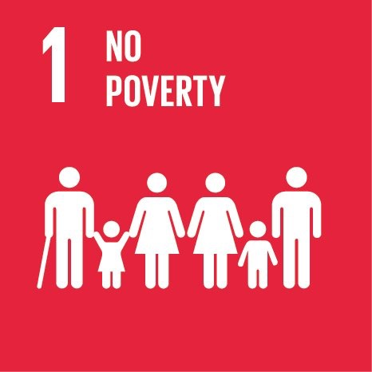






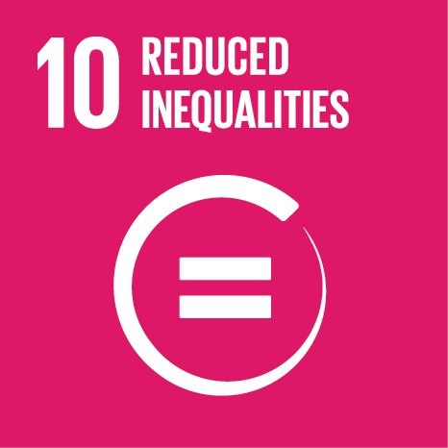

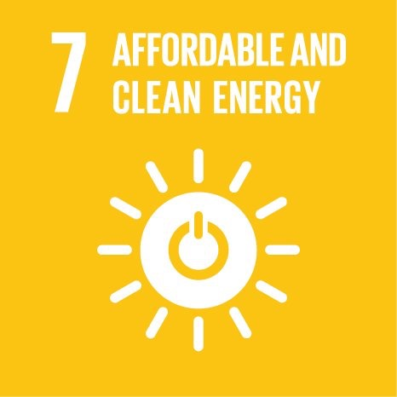

Measuring progress on chemicals and waste in the SDG context

