Slide 1

Katinka Weinberger
Chief,
Environment and Development Policy Section
ESCAP

Slide 2

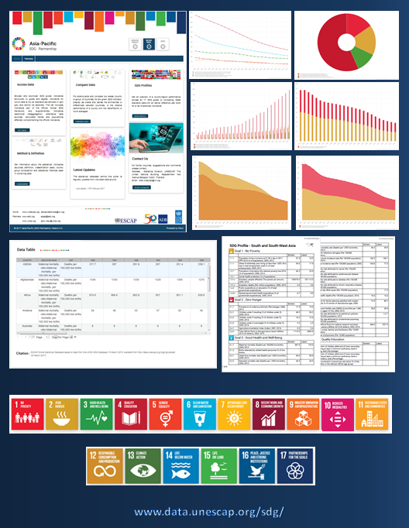
High-level
Political Forum
ESCAP/ADB/UNDP
Asia-Pacific SDG Partnership
Yearly regional reports aligned with HLPF theme
SDG Data Portal: SDG indicators from the globally agreed framework for which data sources could be identified
Follow-up and Review
Asia-Pacific Forum on
Sustainable Development
Annual, inclusive and intergovernmental
Support countries & enhance their capacity for implementation of the 2030 Agenda
Provide regional perspective, identify regional trends, share best practices and lessons learned
Support follow-up and review, assess progress and enable peer learning related to HLPF themes
Sub regional Preparatory
Meetings for APFSD
Enhance awareness and understanding of the theme of the upcoming HLPF
Identify ways to strengthen implementation efforts through follow up and review
Opportunity for peer learning
UN System
Reference groups led by custodian agencies
Develop goal profiles for SDGs under in-depths review
Input to the APFSD
VNR Support
Support member States in the preparation of the VNR presentation and main messages
Notes:
E/ESCAP/RES/72/6
Committing to the effective implementation of the 2030 Agenda for Sustainable Development in Asia and the Pacific
E/ESCAP/RES/73/9
Regional road map for implementing the 2030 Agenda for Sustainable Development in Asia and the Pacific
70/1 of 25 September 2015, entitled “Transforming our world: the 2030 Agenda for Sustainable Development”, and resolution 70/299 of 29 July 2016 on the follow-up and review of the 2030 Agenda at the global level, in which the importance of the regional and subregional dimension of follow-up and review of the 2030 Agenda was acknowledged
ESCAP/ADB/UNDP Asia-Pacific SDG Partnership
With the start of the implementation of the 2030 Agenda, ESCAP-ADB-UNDP established a partnership to support the Sustainable Development Goals (SDGs) and to develop knowledge products, evidence-based policy advocacy, monitoring of the SDGs, and capacity development to strengthen regional follow up and review and national implementation efforts.

Slide 3






The 2019 High-Level Political Forum
2019 THEME: Empowering people and ensuring inclusiveness and equality
SDGs under review:
51 VNRs: including Azerbaijan*, Cambodia, Fiji, Kazakhstan, Indonesia*, Mongolia, Nauru, New-Zealand, Pakistan, Palau, The Philippines*, Timor-Leste, Tonga, Turkmenistan, Turkey, Vanuatu.
*: second time

Slide 4
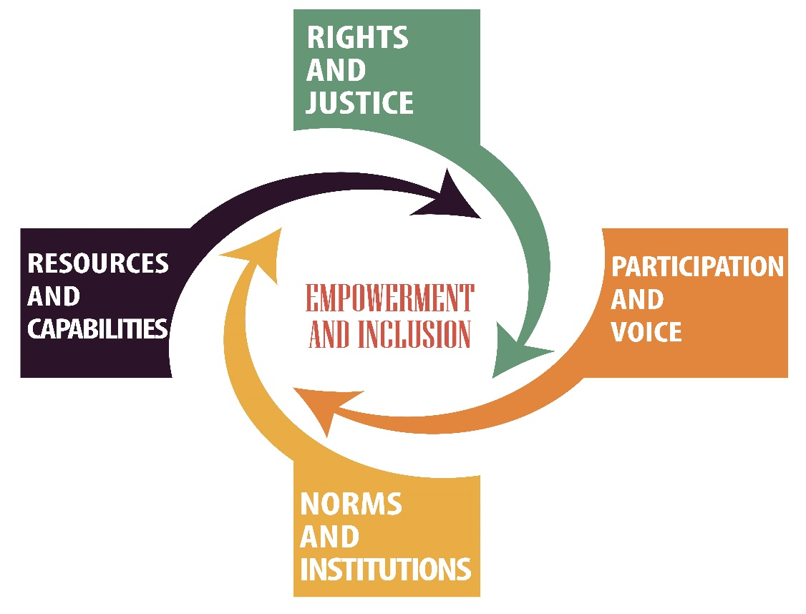
6th APFSD: March 27-29, 2019 in Bangkok
Review of the theme
In-depth review of goals in parallel Roundtables
Voluntary National Reviews
Progress on the roadmap
AND
VNR Café & Engagement space
Pavilion of Partnerships and Side Events (https://www.surveygizmo.com/s3/4748158/Call-for-Proposal-APFSD-2019-Side-Event)
Pre-events (SIDA, UNV, VNR training, Peoples Forum)
http://www.unescap.org/events/apfsd6

Slide 5
Mainstreaming the 2030 Agenda for Sustainable Development:
Stakeholder Engagement

Slide 6
Engagement of non-government actors in the 2030 Agenda is not “business as usual” ….
2030 Agenda commitments
“Leave no one behind”; Inclusion; partnership (Goal 17), participation
Policy coherence, balanced integration of the three dimensions of sustainable development – economic, social and environmental
Effective institutions, transparency & accountability (Goal 16)

Slide 7
How can non-government actors contribute?
Planning
Help develop social, political and scientific consensus on priorities & targets
Delivery/action
Follow up and review
Data gaps
Strengthen integration and policy coherence
Ensuring that the perspectives of the disadvantaged are taken into account
Spread the word - public outreach and awareness
Partnerships for delivery
Help define data disaggregation needs
Shared vision and awareness at national/province/district & community levels
Develop social consensus on progress, priorities and gaps
Notes:
Each area of implementation of the 2030 Agenda activity has different purposes for engagement.
When we look at the area of planning – it is about developing consensus and understanding inter-relationships as a basis for integrated and coherent policy, and about ensuring that marginalized and impacted groups are part of the conversation. We can also engage stakeholders in ensuring that resources are effectively allocated.
When we look at the area of delivery/action
It is about creating ownership an motivating stakeholders to act. We need here pubic outreach, developing shared vision and aligning the interests of different stakeholders to promote partnerships.
In the area of follow up and review,
We need to have

Slide 8
Stakeholder engagement is ..
PURPOSEFUL: An intentional process that has a clear objective and is mostly planned
INFLUENTIAL: Provides opportunities to shape decisions and actions of individuals, communities and/or organizations
ITERATIVE: Recognizes of the interrelationships between the decisions and actions of organizations, stakeholders, communities and individuals
COLLABORATIVE: Recognizes the rights and responsibilities and roles of organizations, stakeholders, communities and individuals.

Slide 9

Stakeholder
Engagement Policy
A good first step towards institutionalized engagement is to develop appropriate policy and practice frameworks to inform practice and capacity building.
The policy should set out a vision for engagement, with a description of how it aligns with decision making, and explains the role of the stakeholders.
It should establish the standards of engagement that institutions are expected to meet, and the issues and decisions on which engagement is needed.
Policies for engagement can exist at the national or sub-national levels.

Slide 10




4 Dimensions of quality engagement
Clear objective, a plan, resources, responsibility & follow up
Barriers to participation (cultural, ability, geographic, other) removed/recognized, stakeholders mapped and analyzed, ensuring “no one left behind”
Facilitates collaboration, empowerment, partnership, cross-sectoral, multi-perspective dialogue to develop shared understanding and build trust
Outreach, involve stakeholders in designing participation, provide information and feedback needed & institutionalize
PURPOSEFUL ENGAGEMENT
INCLUSIVE ENGAGEMENT
TRANSFORMATIVE ENGAGEMENT
PROACTIVE ENGAGEMENT
- Based on ESCAP & IAP2 preliminary framework

Slide 11
Planning for engagement in the VNR - good practice
Defining a clear objective for your engagement with stakeholders
Review the planned report structure and identify the specific points at which stakeholder input will be sought & input (what input, who, how?)
Map your stakeholders (ensuring inclusion, identifying partners) – ideally in a participatory exercise
Defining the right institutional lead is critical (trust, impartiality, competence, involvement in the process) – responsibility & resources
Communicate the entry points clearly & early on to stakeholders
Communicate early with the Stakeholder platforms/bodies on the plans and consult on inputs that could be provided by stakeholders
Develop some basic communication material that can be quickly shared with stakeholders on substance and process. Is there a role that the media can play – as partners ?
Planning for after the VNR

Slide 12
Initial steps
Use the VNR process to explore opportunities & pathways to institutionalization
Very often the VNR process exposes weaknesses/gaps in engagement “infrastructure” or trust. The report can document steps taken, lessons learned, & intention to continue with processes that are not yet complete
Dialogue with stakeholders
- What can stakeholders contribute to the VNR short term and long term across planning, delivery, monitoring?
- How would they like to be engaged?
- What are there specific expectations and needs?
Dialogue within government
- How does engagement support ministry/agency mandates ? (accountability, service delivery, other?)
- Who are your stakeholders?
- Standards (what, how, responsibility, capacity, tools)

Slide 13
Some under-exploited opportunities..
Potential strengthening governance & development outcomes through better understanding of interlinkages
Exploring persistent issues and areas where there are shortcomings
Understanding and addressing the leave no one behind imperative
Strengthening technical assessments & official data sources with stakeholder views
Moving beyond standard workshops – specific methods for integration and meaningful, informed deliberation are available

Slide 14
ESCAP support on stakeholder engagement to date
Developing planning and assessment tool
Technical assistance to VNR countries
Intensive professional development workshop on stakeholder engagement, tailored to the 2030 Agenda
Training material, facilitators oriented to the 2030 Agenda
Orientation/planning workshop for the VNR including stakeholder engagement & integration (for policy coherence)
> Again partnership is critical – ESCAP partners with the International Association for Public Participation

Slide 15
Thank you !
Environment and Development Division
ESCAP

