Slide 1

Katinka Weinberger
Chief,
Environment and Development Policy Section
ESCAP

Slide 2
Guiding principles for Follow-up and Review
Voluntary and country-led
Track progress in a holistic and integrated way
Longer-term orientation
Support reporting by all relevant stakeholders
People-centered, gender sensitive, respecting human rights, leave no one behind
Building on existing platforms and processes
Rigorous, evidence-based, high quality data
Enhance capacity-building support for developing countries
“Active support” by the UN system and other multilateral institutions
Notes:
Effective follow-up and review is critical for effective implementation of the 2030 Agenda for Sustainable Development. This is well-recognized in the 2030 Agenda document which contains 18 paragraphs on the roles, importance, and guiding principles of follow-up and review.
As part of its follow-up and review mechanisms, the 2030 Agenda for Sustainable Development encourages member states to “conduct regular and inclusive reviews of progress at the national and sub-national levels, which are country-led and country-driven” (paragraph 79). These national reviews are voluntary and state-led and are expected to serve as a basis for the regular reviews by the high-level political forum (HLPF), meeting under the auspices of ECOSOC. As stipulated in paragraph 74 of the 2030 Agenda, regular reviews by the HLPF are to be voluntary, state-led, undertaken by both developed and developing countries, and shall provide a platform for partnerships, including through the participation of major groups and other relevant stakeholders.
Guiding principles of FUR are:
Voluntary and country-led, take into account different national realities and capacities;
Track progress in implementing SDGs, including means of implementation. Promotes Interlinkages beyond siloed themes and the integration of the three dimension of Sustainable Development;
Maintain a longer-term orientation, identify achievements, challenges, gaps and success factors. This will help mobilize resources in terms on Means of Implementation (MoI) and Partnerships;
Open, inclusive, participatory and transparent;
People-centered, gender-sensitive, respect human rights, focus on poorest, most vulnerable;
Build on existing platforms and processes, avoid duplication, and minimize reporting burden;
Rigorous and based on evidence, informed by country-led evaluations and disaggregated data; data should be of “high-quality, accessible, timely, reliable and disaggregated.”
Requires enhance capacity-building support for developing countries, including strengthening of national data systems and evaluation
Benefits from active support of the UN system and other multilateral institutions

Slide 3
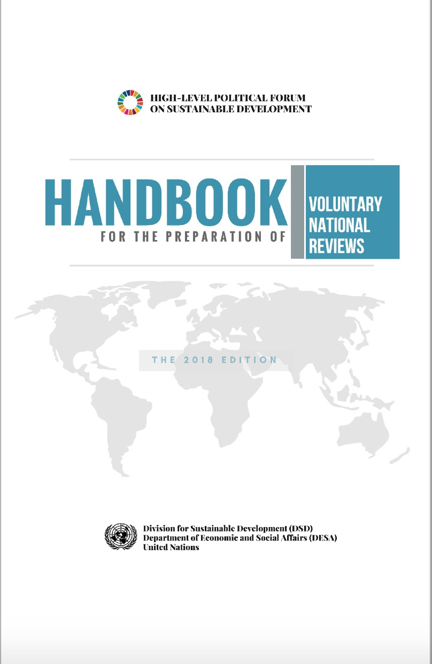
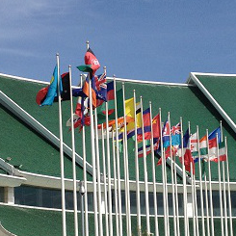

Review process in the Asia-Pacific region
Thematic reviews by functional commissions, major groups and stakeholders, international organizations
National Reviews:
VNR
National SDG progress report
APFSD:
Regional SDG progress report (ESCAP)
Thematic report (ESCAP/ADB/UNDP)
Goal profiles (UN system)
Financing for Development Forum
HLPF:
47 VNRs (2018)
51 VNRs (2019)
SDG global processes report (annual)
Global Sustainable Development report (quadrennial)
STI Forum
Notes:
A/RES/70/1 frames follow-up and review around national, regional and global processes and call for a robust, voluntary, effective, participatory, transparent and integrated follow-up and review framework
Key points of the FUR system are:
Voluntary and country-led
Respecting the universal integrated and interrelated nature of the 17 SDGs and the three dimensions of sustainable development
Building on existing platforms and processes
Longer-term orientation
Support reporting by all relevant stakeholders
People-centered, gender sensitive, respecting human rights and having a particular focus on the poorest, most vulnerable and those furthest behind
Data should be of “high-quality, accessible, timely, reliable and disaggregated.”
Enhance capacity-building support for developing countries (e.g. least developed countries, small island developing States, landlocked developing countries and middle-income countries), particularly in the areas of strengthening national system and evaluation programmes.
The UN system and other multilateral institutions are to provide “active support” to the follow-up and review process

Slide 4

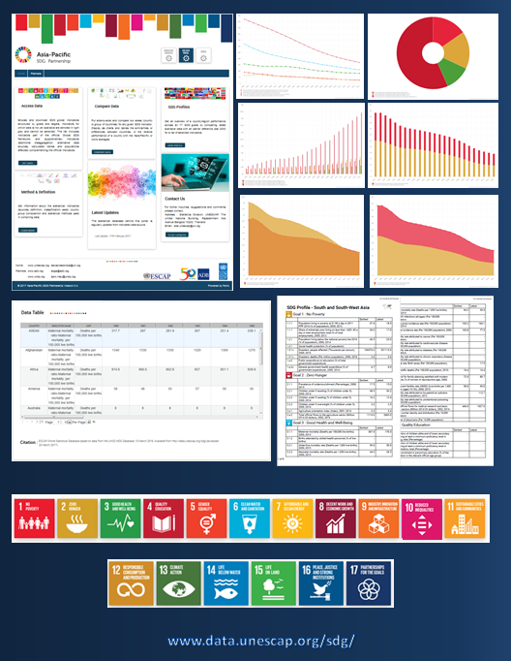
Follow-up and Review
High-level
Political Forum
Asia-Pacific Forum on
Sustainable Development
Annual, inclusive and intergovernmental
Support countries & enhance their capacity for implementation of the 2030 Agenda
Provide regional perspective, identify regional trends, share best practices and lessons learned
Support follow-up and review, assess progress and enable peer learning related to HLPF themes
Support presentation of VNRs, review progress of regional road map
ESCAP/ADB/UNDP
Asia-Pacific SDG Partnership
Yearly regional reports aligned with HLPF theme
Tracking the progress of SDGs: snapshot analysis across all SDGs in the region
SDG Data Portal: SDG indicators from the globally agreed framework for which data sources could be identified
Sub regional Preparatory
Meetings for APFSD
Enhance awareness and understanding of the theme of the upcoming HLPF
Identify ways to strengthen implementation efforts through follow up and review
Opportunity for peer learning
VNR Support
Support member States in the preparation of the VNR presentation and main messages
Notes:
E/ESCAP/RES/72/6
Committing to the effective implementation of the 2030 Agenda for Sustainable Development in Asia and the Pacific
E/ESCAP/RES/73/9
Regional road map for implementing the 2030 Agenda for Sustainable Development in Asia and the Pacific
70/1 of 25 September 2015, entitled “Transforming our world: the 2030 Agenda for Sustainable Development”, and resolution 70/299 of 29 July 2016 on the follow-up and review of the 2030 Agenda at the global level, in which the importance of the regional and subregional dimension of follow-up and review of the 2030 Agenda was acknowledged
ESCAP/ADB/UNDP Asia-Pacific SDG Partnership
With the start of the implementation of the 2030 Agenda, ESCAP-ADB-UNDP established a partnership to support the Sustainable Development Goals (SDGs) and to develop knowledge products, evidence-based policy advocacy, monitoring of the SDGs, and capacity development to strengthen regional follow up and review and national implementation efforts.

Slide 5






The 2019 High-Level Political Forum
2019 THEME: Empowering people and ensuring inclusiveness and equality
SDGs under review:
51 VNRs: including Azerbaijan*, Cambodia, Fiji, Kazakhstan, Indonesia*, Mongolia, Nauru, New-Zealand, Pakistan, Palau, The Philippines*, Timor-Leste, Tonga, Turkmenistan, Vanuatu.
*: second time

Slide 6
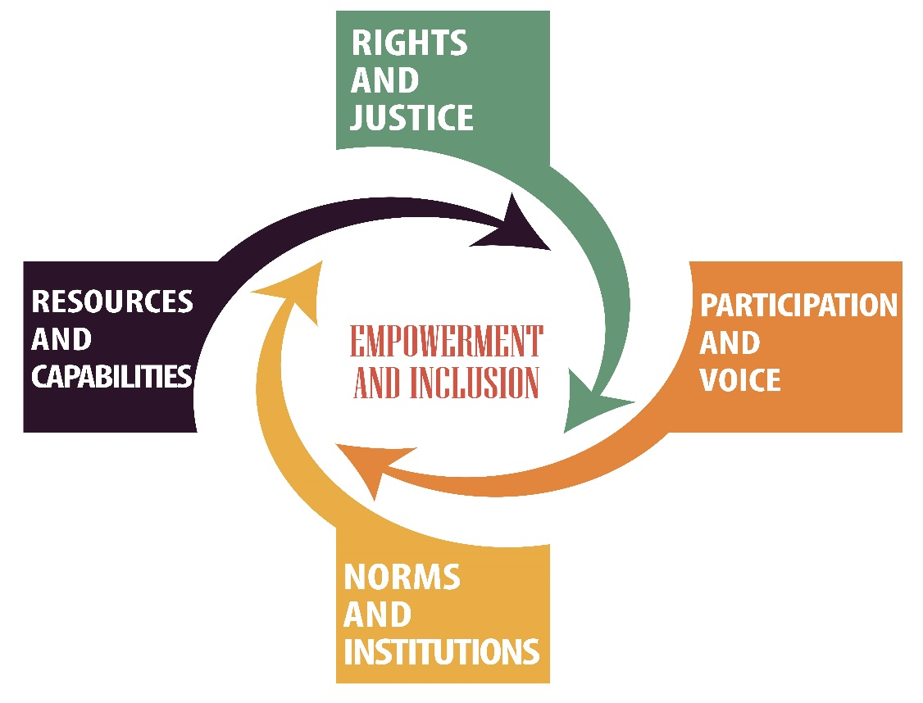
6th APFSD: March 27-29, Bangkok
Thematic review of the theme
In-depth review of the cluster of goals
Follow up and review of national progress and achievements through VNR session (and panel discussions and innovative spaces such as the)
Strengthening implementation by assessing progress on the roadmap
AND
VNR Café, Engagement space
Pavilion of Partnerships and Side Events
https://www.surveygizmo.com/s3/4748158/Call-for-Proposal-APFSD-2019-Side-Event
http://www.unescap.org/events/apfsd6
To be preceded by a series of events (SIDA, UNV, Peoples Forum)

Slide 7
Thank you !
Environment and Development Division
ESCAP

Slide 8
Regional Road Map for implementing the 2030 Agenda in Asia and the Pacific
Background and process
Based on extensive dialogue between member states and inputs from civil society organizations and the broader UN community, Asia and the Pacific developed a regional road map for implementing the 2030 Agenda.
The road map stemmed from decisions mandated at the Second and Third Asia- Pacific Forums on Sustainable Development (APFSD) in 2015 and 2016.
The road map was adopted in March 2017 - in the Fourth session of the APFSD.
It is the only inter-governmentally agreed, member-state driven, regional roadmap for implementing the 2030 Agenda.

Slide 9
A Regional Road Map for Asia and the Pacific
Expectation
Strengthen regional cooperation on priority issues
Enabled continued and more efficient and coordinated support
Facilitate more effective knowledge sharing
Practical means of implementation
Data and statistics
Technology
North-South, South-South, international and regional partnerships
Finance
Policy coherence
Thematic areas with multisectoral impacts
Leave no one behind
DRR & resilience
Climate change
Natural resource management (including Oceans)
Connectivity
Energy

